Slide 1
AI-POWERED LEGAL DOCUMENTATION SYSTEM
PIP4004 University Project
Final Review
Group Number: IST-02
Roll Number | Student Name
20211IST0002 | Sugunashree M K
20211IST0003 | Huzaifa Shariff
20211IST0020 | Shamitha R
Under the Supervision of,
Assistant Prof.Monisha Gupta
School of Computer Science & Engineering
Presidency University
Name of the Program Project Coordinator: Assistant Prof. Srinivas Mishra
School of Computer Science & Engineering
Presidency University

Slide 2
Introduction
The "AI-Powered Legal Documentation Assistant" is an innovative solution designed to revolutionize the legal documentation process.
This cutting-edge system leverages advanced artificial intelligence algorithms to simplify complex legal jargon, ensuring compliance with local laws and making legal procedures accessible to individuals and small businesses in India.
With a user-friendly interface, it allows effortless input of contract details and generates documents in plain language.
Furthermore, the assistant offers comprehensive compliance checks to ensure adherence to the latest legal standards, customizable templates, integration with legal databases, and expert consultation for complex cases.
Beyond document creation, it aims to empower users with legal literacy, fostering greater understanding and accessibility in the legal realm.

Slide 3
Literature Review
Author | Year | Title | Existing Method | Proposed method | Outcomes
Hemlata Sharma; Aakanksha | 2019 | Artificial Intelligence and Law: An Effective and Efficient Instrument | Mention of AI's potential in law, AI use in e-courts and software. | Introduction to AI and Law; Exploration of AI's impact on the legal field | Introduction to the AI-law connection; Discussion of AI's influence on legal processes and practices
Dipali Baviskar; Swati Ahirrao; Vidyasagar Potdar; Ketan Kotecha | 2020 | Efficient Automated Processing of Unstructured Documents Using AI: A Systematic Literature Review and Future Directions | Discussion on traditional information extraction techniques; Need for AI-based solutions for unstructured documents | Analysis of existing information extraction techniques; Proposal for a high-quality dataset; Need for business-research collaboration. | Identification of AI's potential in extracting information from unstructured documents; Call for better datasets and industry-academic cooperation.

Slide 4
Literature Review
Author | Year | Title | Existing method | Proposed Method | Outcomes
Santosh K. Maher; Suvarnsing G. Bhable; Ashish R. Lahase; Sunil S. Nimbhore | 2022 | AI and Deep Learning-driven Chatbots: A Comprehensive Analysis and Application Trends | Overview of chatbots in various industries; AI and deep learning-based chatbots. | In-depth analysis of chatbots, Comparison based on features and application areas. | Comprehensive analysis of chatbots, their trends, and technologies; Highlighting AI and deep learning-based chatbots as essential tools for customer interactions.
San Murugesan; Aswani Kumar Cherukur | 2023 | The Rise of Generative Artificial Intelligence and Its Impact on Education | Discussion on generative AI in various domains; Mention of ChatGPT by OpenAI. | Exploration of GAI's impact on education and research. | Recognition of the transformative potential of GAI; Acknowledgment of opportunities and challenges in the AI text-writing tool ChatGPT.

Slide 5
Literature Review
Author | Year | Title | Existing method | Proposed method | Outcomes
Miguel A. Cardona; Roberto J. Rodríguez | 2021 | Artificial Intelligence and the Future of Teaching and Learning | General information about AI's potential impact on teaching and learning. | Information about AI’s potential to learn | General information about AI's potential impact on teaching and learning.
Kuldeep Wayadande, Aditi Bhatt, Pranav Bachhav | 2024 | AI Powered Legal Documentation Assisstant | Traditional legal documentation relies on manual processes, which are time-consuming and prone to errors | The authors propose an AI-driven system that utilizes natural language processing and machine learning to analyze user input and provide context-aware recommendations for legal document creation. | Implementing this AI assistant is expected to enhance efficiency, improve accuracy, and increase accessibility in legal document management.

Slide 6
Literature Review
Author | Year | Title | Existing method | Proposed method | Outcomes
Rithik Raj Pandey; Sarthak Khandelwal; Satyam Srivastava; Yash Triyar; Mrs. Muquitha Almas | 2024 | LEGALSEVA - AI-powered legal Documentation Assisstant | Traditional legal documentation relies on manual processes, leading to inefficiencies and increased potential for errors. | The authors propose an AI-driven system that utilizes natural language processing and machine learning to analyze user inputs and provide context-aware recommendations for legal document creation. | Implementing this AI assistant is expected to enhance efficiency, improve accuracy, and increase accessibility in legal document management.
awez shaikh Rizvi Mohd Farhan Zahid Zakir Hussain Shaikh Azlaan | 2024 | AI-Powered Legal Documentation Assistant | Traditional legal documentation in India is often complex, requiring individuals to navigate intricate legal jargon and processes without adequate resources. | The AI-Powered Legal Documentation Assistant leverages large language models to simplify legal document drafting, provide user-friendly summaries, and offer expert legal advice, enhancing accessibility and efficiency. | Implementing this AI assistant aims to empower individuals by making legal processes more efficient and accessible, contributing to a fairer and more inclusive legal system in India.

Slide 7
Literature Review
Author | Year | Title | Existing method | Proposed method | Outcomes
Vimala Imogen; J.Sreenidhi; V,Nivedha | 2024 | AI Powered Legal Documentation Assistant | Traditional legal documentation processes often involve manual drafting and review, leading to inefficiencies and increased potential for errors. | The AI-Powered Legal Documentation Assistant integrates artificial intelligence technologies, including AI-powered chatbots and personalized bots, to provide real-time assistance, guidance, and tailored support to clients navigating complex legal requirements. | Implementing this AI-driven platform aims to democratize access to legal information, empower individuals and businesses to navigate legal processes more efficiently.
Gobind Naidu1, Vicknesh Krishnan2 | 2025 | Artificial Intelligence-Powered Legal Document Processing for Medical Negligence Cases: A Critical Review | Traditional legal document processing in medical negligence cases relies heavily on manual review and analysis, which is time-consuming and prone to human error. | The integration of artificial intelligence (AI) into legal document processing aims to enhance efficiency and accuracy by automating tasks such as document review and data extraction. | Implementing AI in this context has led to a 60% reduction in document review time, improved accuracy, however, challenges like data quality issues, gsystems persist.

Slide 8
Objectives
Here are five main objectives of this project:
Simplify Legal Documentation: Develop an AI-powered solution to automate the drafting of legal documents in plain, easy-to-understand language for individuals and small businesses in India.
Enhance Accessibility to Legal Resources: Provide a user-friendly interface and customizable document templates, reducing dependency on expensive legal services and minimizing errors.
Ensure Accuracy and Completeness: Integrate with existing legal databases and resources to validate the correctness and comprehensiveness of the generated documents.
Support Customization and Flexibility: Allow users to tailor legal documents to their specific needs while maintaining legal validity and clarity.
Promote Legal Awareness and Education: Help users better understand their rights and obligations by presenting legal terms and clauses in simple, easy-to-grasp language.

Slide 9
Methodology
1. Requirement Analysis
Identify the most common legal documents needed by individuals and small businesses in India (e.g., rental agreements, employment contracts, partnership deeds).
Gather input from legal professionals and end-users to understand pain points and requirements.
Define the scope of the AI solution-types of documents, language simplification, customization options, and expert consultation needs.
2. Data Collection and Preparation
Source publicly available legal databases, document templates, and legal language resources.
Clean and preprocess legal texts to remove jargon and make the language more accessible.
Build a dataset of plain-language legal documents for training AI models.
3. AI Model Development
Natural Language Processing (NLP): Train models to convert legal jargon into easy-to-understand terms while retaining legal accuracy.
Document Generation: Use template-based generation combined with AI for filling in user-specific information.
Customization Engine: Enable dynamic adjustments to terms, clauses, and document structure based on user input.

Slide 10
Methodology
4. User-Friendly Interface Design
Build a clean, intuitive interface for users to input details like parties involved, agreement terms, and specific requirements.
Incorporate guided workflows and prompts to help users provide the right information without confusion.
5. Legal Database Integration
Connect the system to legal databases and official resources to ensure generated documents are up-to-date and compliant with Indian laws.
Implement automated checks for completeness and accuracy of legal terms and clauses.
6. Testing and Validation
Conduct user testing with individuals and small business owners to evaluate ease of use and clarity.
Collaborate with legal professionals to validate the accuracy and reliability of generated documents.
Test the system for edge cases, language variations, and customization options.

Slide 11
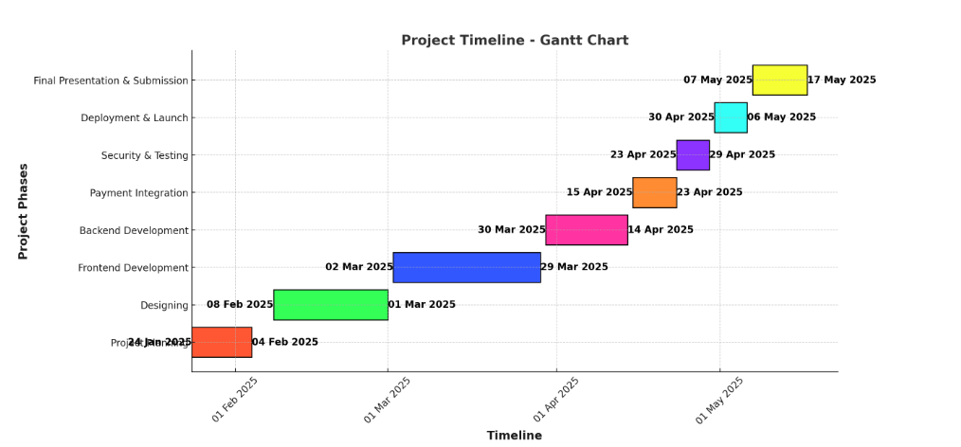
Timeline of Project

Slide 12
Expected Outcomes
A fully functional AI-powered legal documentation assistant with an easy-to-use interface.
Automatically generated legal documents that are accurate, clear, and easy for non-lawyers to understand.
Ability for users to tailor legal documents to their specific needs without compromising legal validity.
Ensured accuracy and completeness by connecting with up-to-date legal resources and databases.
Significant reduction in time and expenses for creating and understanding legal documents.
Robust protection of user information through encryption and secure data handling practices.
A solution designed to scale and adapt to evolving legal requirements and user needs.

Slide 13
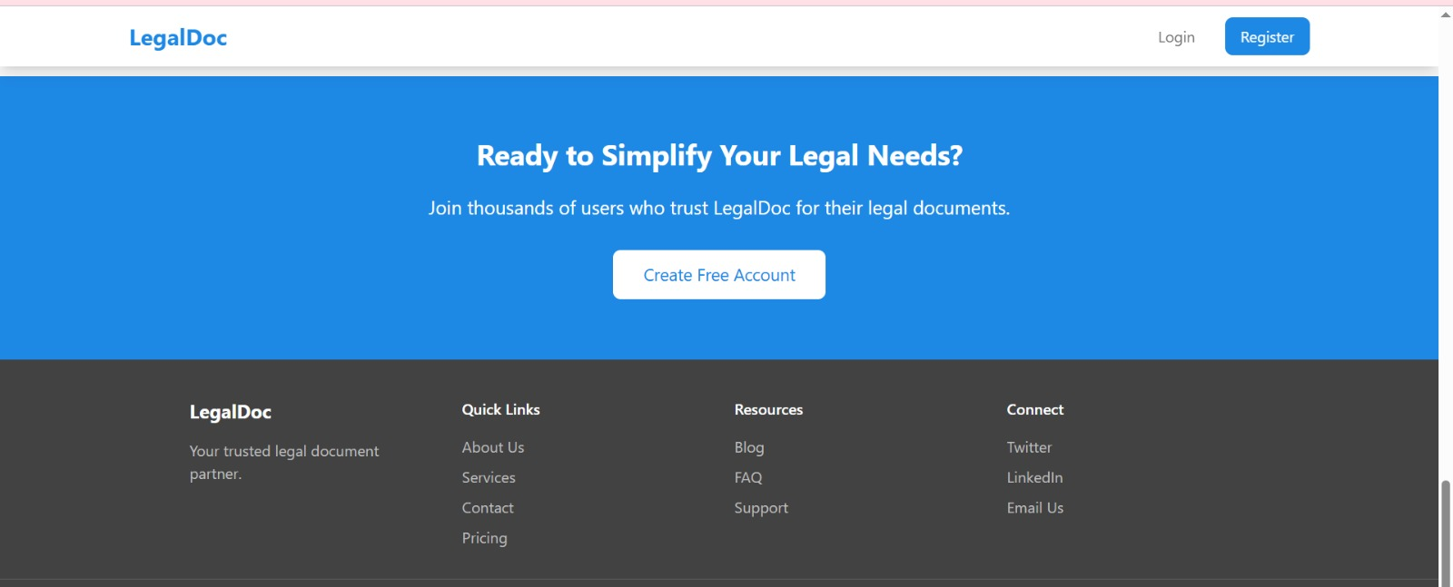
Outcomes

Slide 14
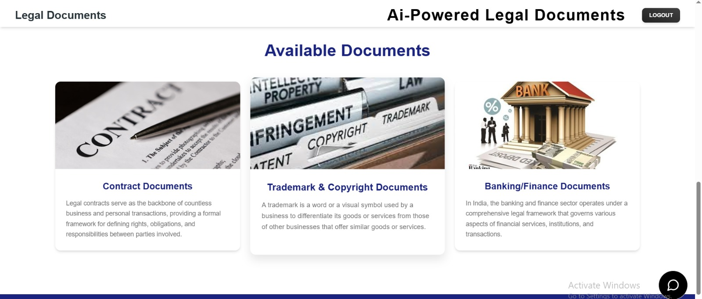
Outcomes

Slide 15
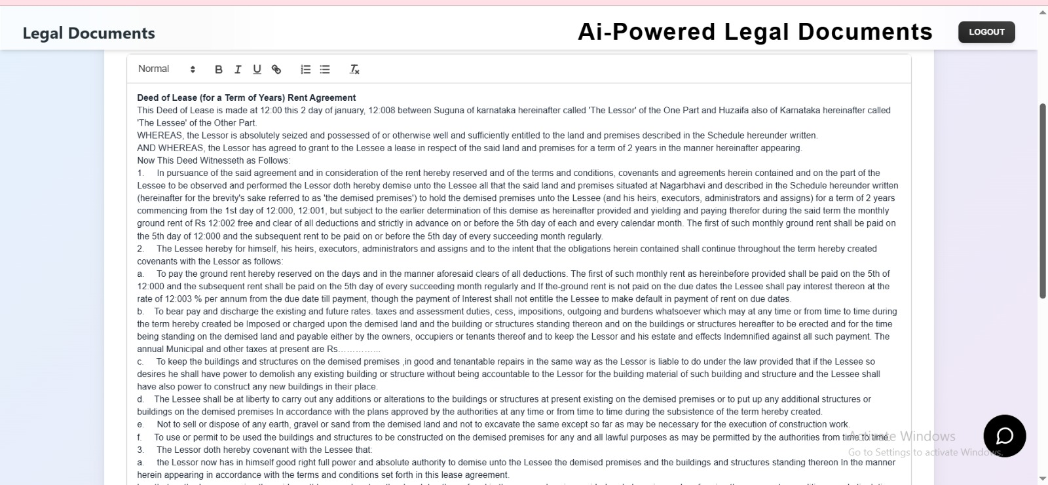
Outcomes

Slide 16
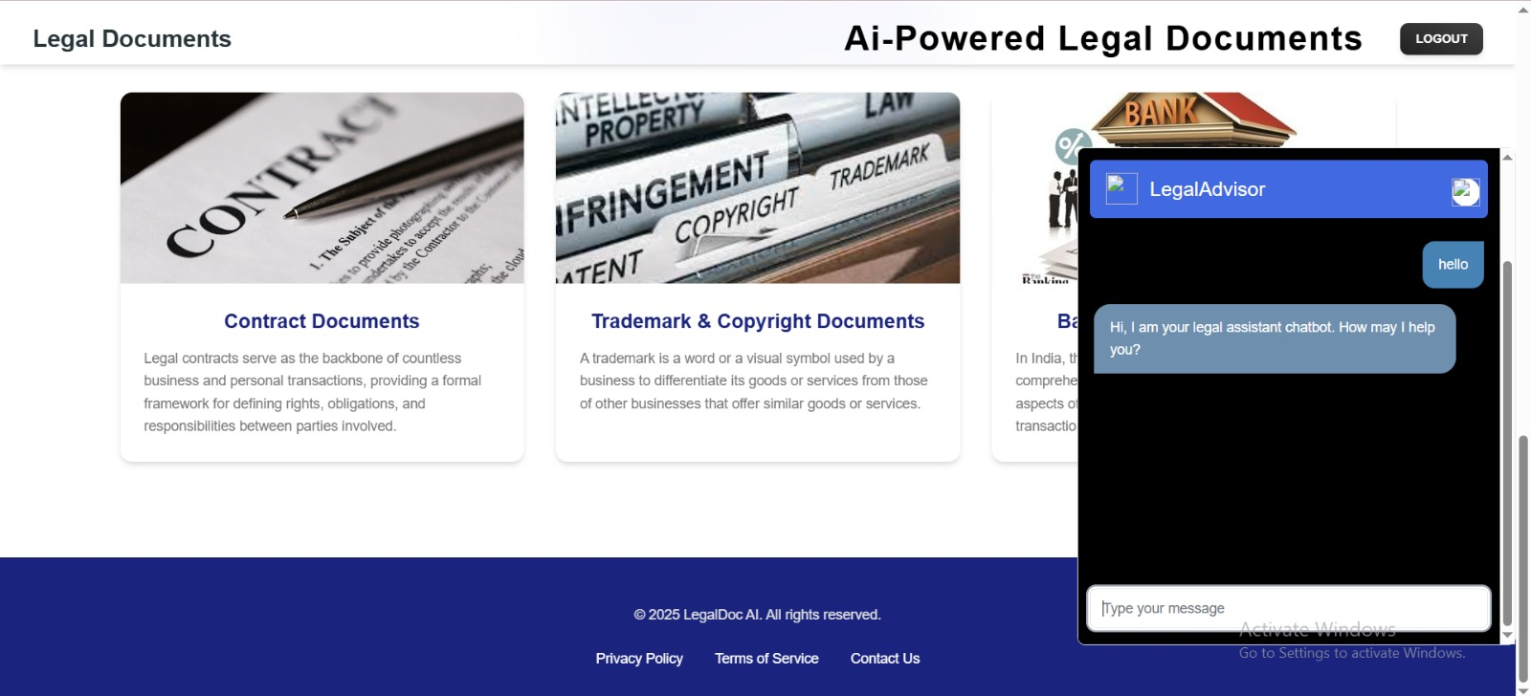
Outcomes

Slide 17
Conclusion
The development of an AI-powered legal documentation assistant has the potential to revolutionize access to legal services for individuals and small businesses in India.
By simplifying the process of drafting legal documents in plain, easy-to-understand language, this solution addresses the challenges posed by complex legal jargon and limited access to legal expertise.
Through features like AI-driven document generation, customization capabilities, and integration with legal databases, it ensures accuracy, efficiency, and clarity in legal documentation.
Moreover, the option to consult legal experts for complex issues, combined with strong data privacy and security measures, makes this solution both practical and trustworthy.
By reducing costs, saving time, and minimizing errors, this tool empowers users to handle legal matters independently and confidently.
Ultimately, this initiative promotes greater legal awareness and increases access to justice, creating a positive and lasting impact on India’s legal ecosystem.

Slide 18
References
Sharma, H., & Aakanksha, N. (2021). Artificial Intelligence and Law: an effective and efficient instrument. 2022 10th International Conference on Reliability, Infocom Technologies and Optimization (Trends and Future Directions) (ICRITO), 1–5. https://doi.org/10.1109/icrito51393.2021.9596503
Baviskar, D., Ahirrao, S., Potdar, V., & Kotecha, K. (2021). Efficient automated processing of the unstructured documents using artificial intelligence: A systematic literature review and future directions. IEEE Access, 9, 72894–72936. https://doi.org/10.1109/access.2021.3072900
Maher, S. K., Bhable, S. G., Lahase, A. R., & Nimbhore, S. S. (2022b). AI and Deep Learning-driven Chatbots: A Comprehensive Analysis and Application Trends. 2022 6th International Conference on Intelligent Computing and Control Systems (ICICCS), 994–998. https://doi.org/10.1109/iciccs53718.2022.9788276
Murugesan, S., & Cherukuri, A. K. (2023). The rise of generative artificial intelligence and its impact on education: the promises and perils. Computer, 56(5), 116–121. https://doi.org/10.1109/mc.2023.3253292
Popenici, S. a. D., & Kerr, S. (2017). Exploring the impact of artificial intelligence on teaching and learning in higher education. Research and Practice in Technology Enhanced Learning, 12(1). https://doi.org/10.1186/s41039-017-0062-8
K. Vayadande, A. Bhat, P. Bachhav, A. Bhoyar, Z. Charoliya and A. Chavan, "AI-Powered Legal Documentation Assistant," 2024 4th International Conference on Pervasive Computing and Social Networking (ICPCSN), Salem, India, 2024, pp. 84-91, doi: 10.1109/ICPCSN62568.2024.00022.

Slide 19
Thank You

